Slide 1
PART IV – Implementation and Demo:
Asogwa Emmanuel
asogwaemmanuel36@gmail.com

Slide 2
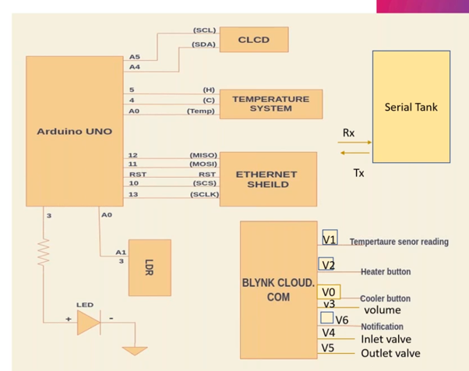
BLOCK DIAGRAM

Slide 3
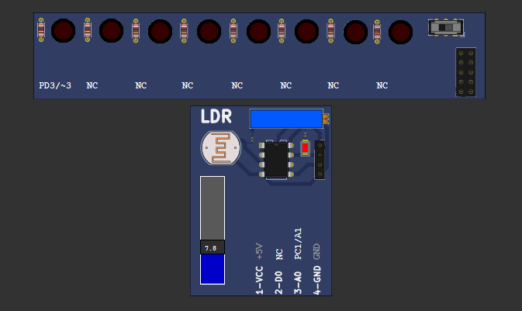
GARDEN LIGHTS CONTROL

Slide 4
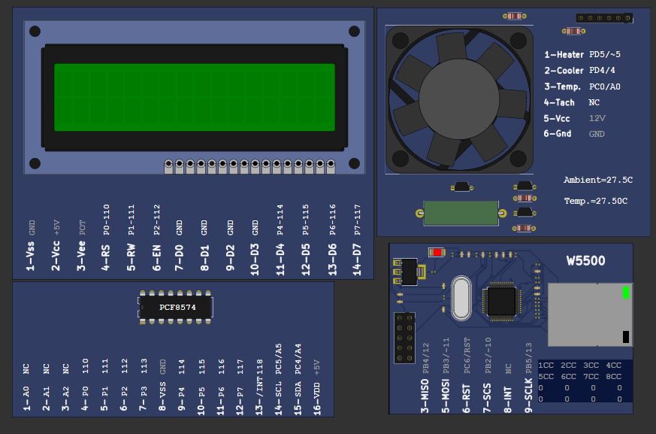
Temperature control

Slide 5
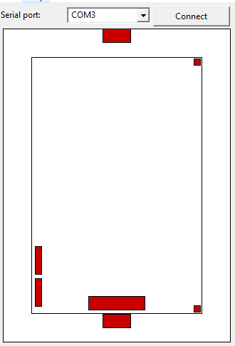
Serial tank control

Slide 6
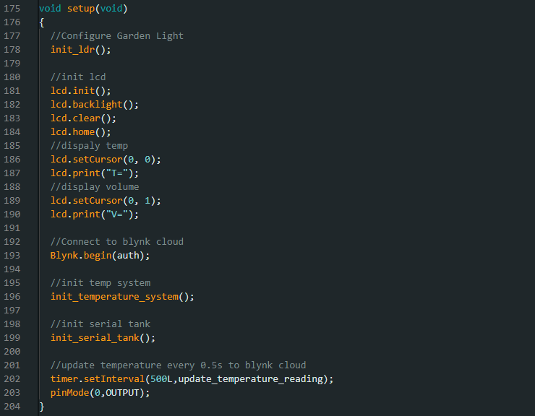
SETUP FUNCTION

Slide 7
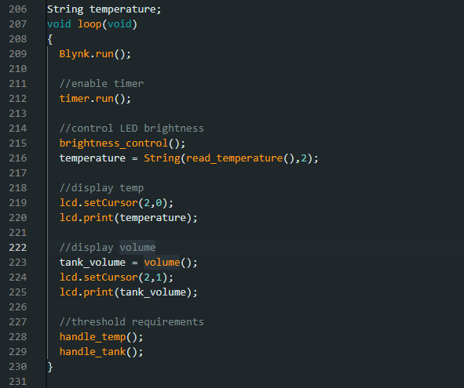
LOOP FUNCTION

Slide 8
OUTPUT

Slide 9
OUTPUT

Slide 10

CONCLUSION
The final result is a simulated Automated Home Project that can be remotely controlled and with a dashboard that displays its status

Slide 11

Thank you

